Slide 3
1994-2004

Slide 4
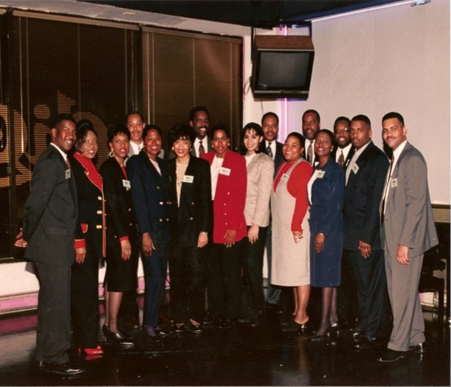
The Original 16
Picture taken March 30, 1995 at our very 1st official event at the Clique, later known as E2 2347 South Michigan.
Can you name all 16 members featured in this photo?

Slide 5
Newsletter – October 1994
Notes:
Oct 1999 Newsletter

Slide 6
Newsletter – October 1994
Notes:
Oct 1999 Newsletter

Slide 7
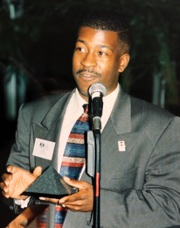
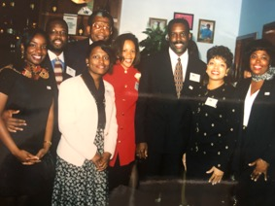
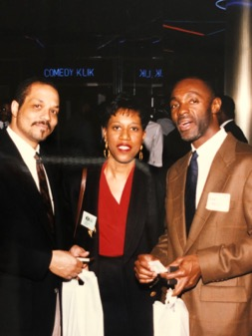
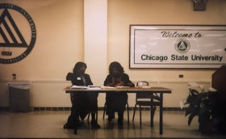
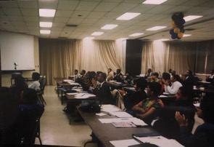
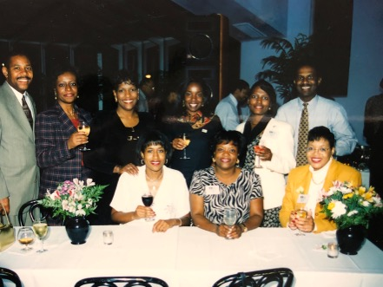
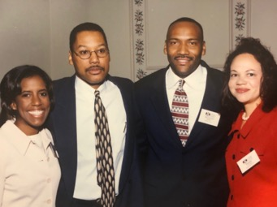
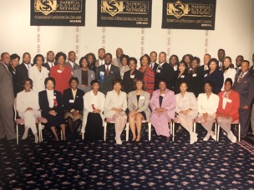

Slide 8
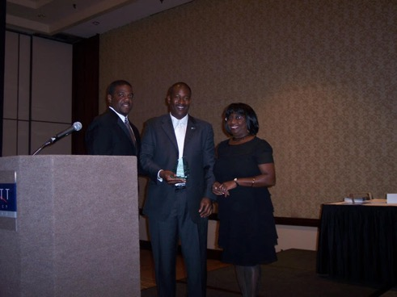
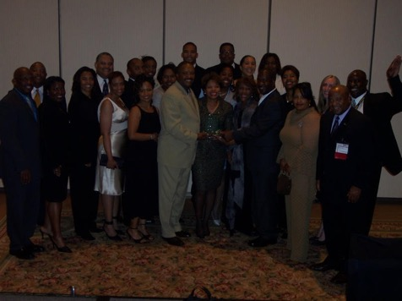
2004 (Three Peat)
Notes:
2004 3 Peat – Accepting for pam

Slide 9
2005 - 2018

Slide 10
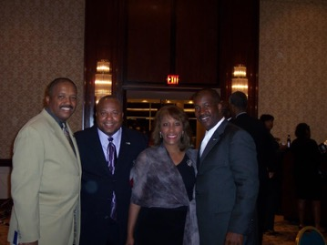
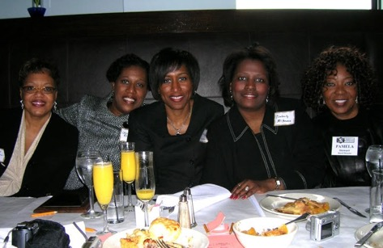
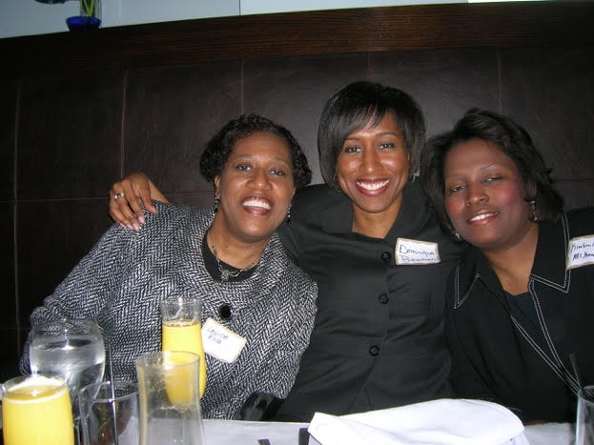
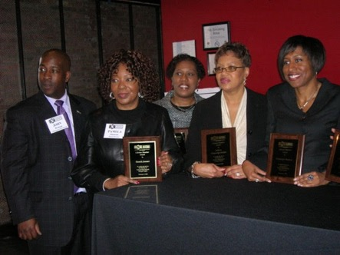
Notes:
Coy #3

Slide 11
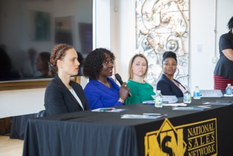
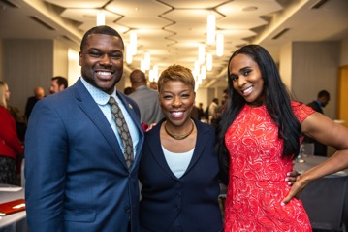
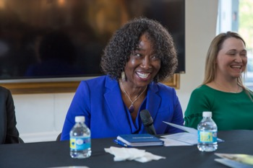
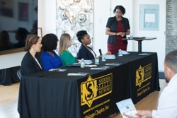
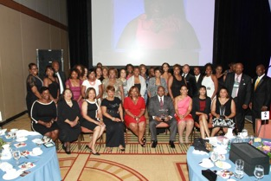
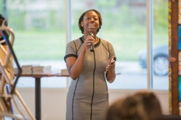
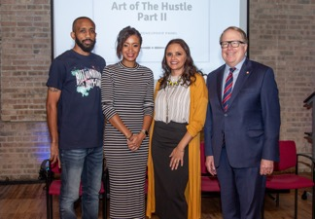
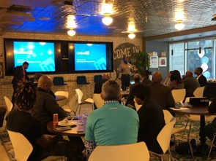
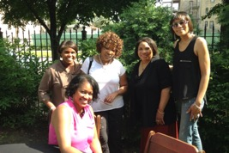
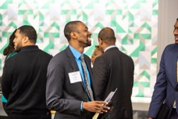

Slide 12
A Look Back at 2019

Slide 13
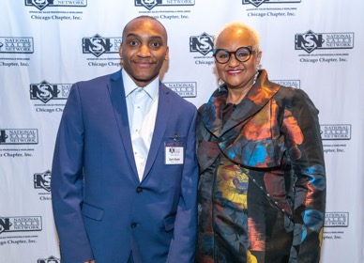
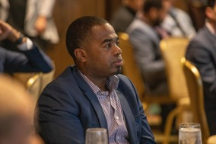
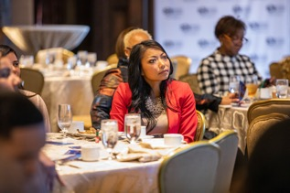
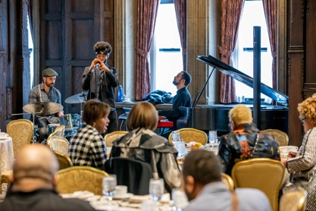
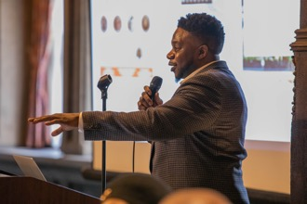
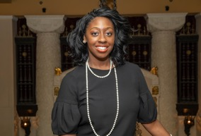

Slide 14
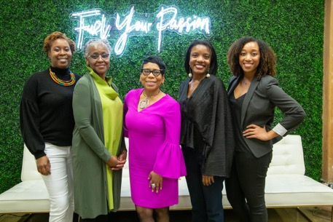
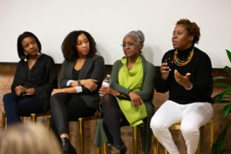
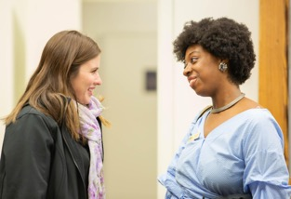
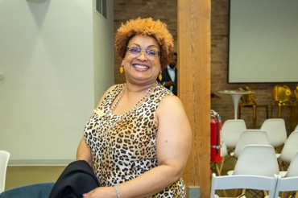
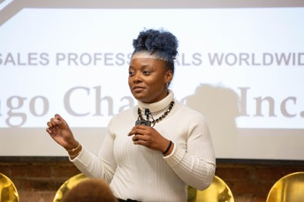
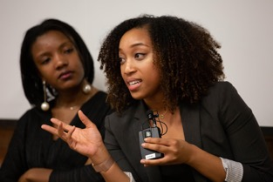

Slide 15
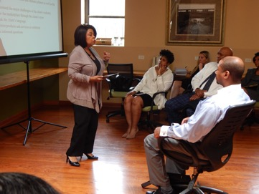
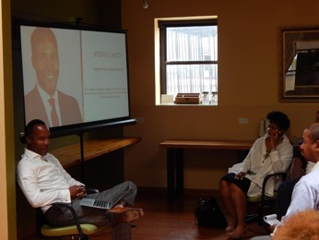
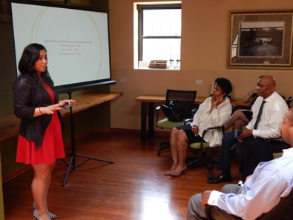
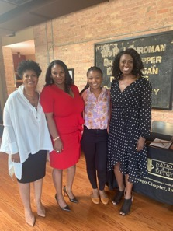
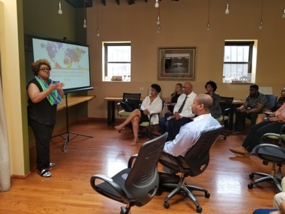

Slide 16
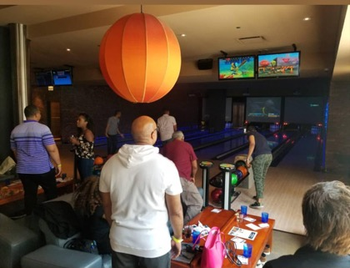
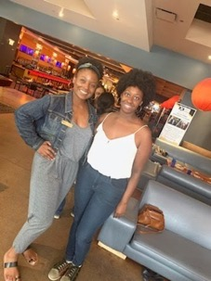
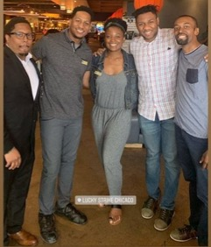
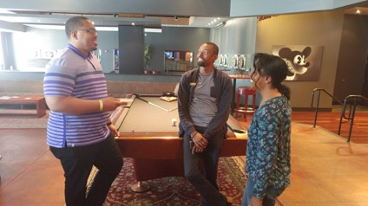
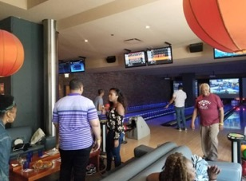

Slide 17
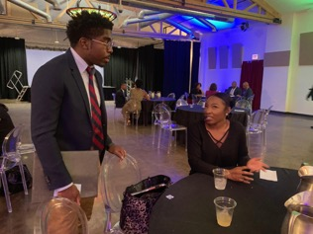
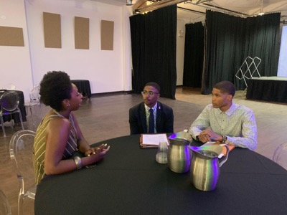
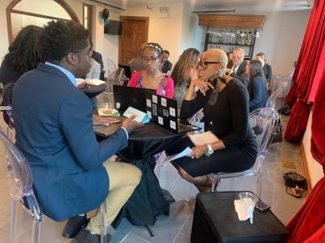

Slide 20
Recognizing our Members and Sponsors

Slide 21
Our Chicago Chapter Architects
Cliff Bailey
Dennis Allen
Shawna Wills
Diana Gregory
Renee Pack
John Erby
Carolyn Booth
Kevin Mott
Donna Miller
Peggy Austin
Mell Monroe
Gwen Harris
Dominique Bowman
Kevin Daniels
Kim Conley-McKenzi
Darrell Jones
Juliette Munnerlyn
Lanita Ross
Curtis Rempson
Gary Foster
Kevin Conway
Kendall Hyatt
Pam Stewart
John Watson

Slide 22
Our 2019 Chapter Officers and Committee Members
President,
Taylor Justin
VP of Events,
Elijah Hamilton
VP of Membership
Kelly Darling
VP of Business Development
Donna Smith Bellinger
Director of Finance
Justin Weaver
Director of Events
Siobhan Goree
Director of Membership
Justin Horton
Director of Marketing
Patrick Simmons
Director of Administration
Daryl Peterson Jr.
Notes:
Presenter – Chapter President
Highlight titles and names (photos which are great if you have them) of each officer.
*Instruct each officer to walk up to the front of the room when the person presenting reads their name and title. All officers should have on their NSN pendant, in addition to a name badge at the event.

Slide 23
Our 2019 Chicago Chapter Sponsors
Notes:
Presenter – VP of Business Development
This slide should have logos of 2019 sponsors
Each attending sponsor should have 1-2 minutes on mic

Slide 24
Stay Connected with us in 2020!
See past event photos, connect with fellow members, and receive the latest chapter updates by liking and following our social media pages.
facebook.com/nsnchi
@nsnchicago
@nsnchicago
Join our Facebook Group and receive notifications about exclusive members only events, codes, and chapter information.
Notes:
Presenter – Marketing

Slide 26
Thank you for celebrating with us!
See you in 2020

Slide 28
P.S.
After the Holiday Party - join us at Municipal!
216 W Ohio St.

